Slide 1
Junior Research Project

Slide 2
1. Choose a time Period (Pages A2-a19) 2. A background of the time period is needed (Half to one page, typed, 12 font, times new roman)
Foundations to 1800
American Romanticism
American Masters
Rise of Realism
The Moderns
Contemporary Literature

Slide 3
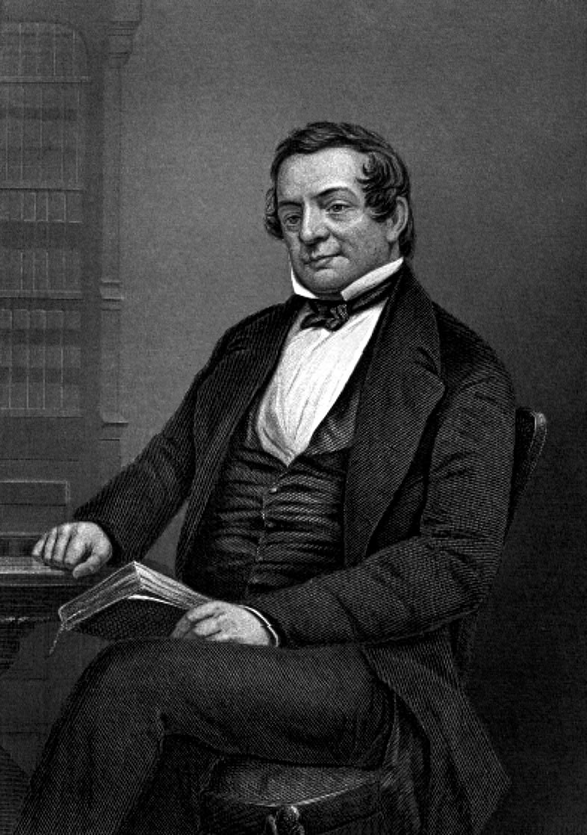
Find three authors who represent that time period

Slide 4
Instructions
Provide one paragraph background information per author
Find one writing sample from each author
Choose two citations from each writing sample to analyze
Find or create artwork related to the writing samples
Four sources must be used
One may be your text
One to two may be online
One may be an online database

Slide 5
Format Must be in poster board or scrapbook form
Must be in MLA Format
Must include a work cited
Must include long and short citations for each writing sample
All writing samples must be cited
Any plagiarism is a zero

Slide 6
Incidentally…
Late projects will not receive full credit
Extra credit will be given for early turn ins
Potential extra credit for fabulousness ☺
Due date: March 13, 2013

